Slide 1
cloud

Slide 2
AWS Account
We will learn AWS Cloud
Create your AWS Account.
Mostly services required for this course are within free tier
So, no cost
Download putty, puttyGen, WIN-SCP tools

Slide 3
Create few useful things
You logged in as root user
Your account is <5abc691cyz46>
On top right menu, click on Security Credentials and assign MFA device
Click on ‘account’ on top right menu
Check if ‘IAM user and role access to Billing information’ is activated
Set Billing Preferences from left menu setting email id for notification
Also click on Budget on left menu and set monthly budget
Get IAM -> on right box create account alias for easy URL to sign in

Slide 4
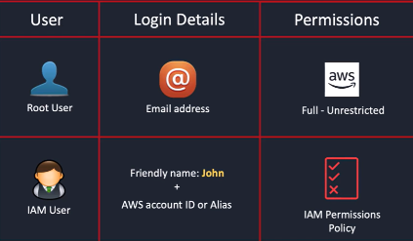
Root vs iam (identity access mgmt) user
Get IAM -> User -> Create User -> provide name and also console access -> select I want to create an IAM user -> give custom password -> create user without any permission yet
At this point this user don’t have any permission
Create a user group ‘admin’ , with AdministratorAccess and add user created above
Also IAM -> AWS Account (right side) -> Create Alias
Logout and go to aws.amazon.com (or alias URL) and select IAM user to login
Put credentials and login
IAM -> Users -> click <user> -> Security credentials -> Assign MFA device

Slide 5
AWS CLI
IAM -> Users -> click <user> -> Security credentials -> Create AccessKeys for cli -> and keep the values saved somewhere
Follow on ubuntu
curl "https://awscli.amazonaws.com/awscli-exe-linux-x86_64.zip" -o "awscliv2.zip"
unzip awscliv2.zip
sudo ./aws/install
aws version
aws configure
( input keys, default region)
On console , there is symbol of cloud shell, where aws commands can be executed

Slide 6
Cloud computing

Slide 7
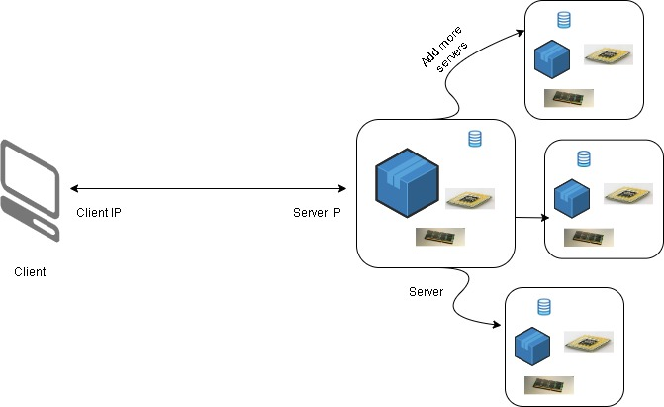
Cloud computing
Client communicate with server within network , say with IP addresses
Server might have CPU,RAM , database to store data, files systems etcs.,
As site grows, we may add more servers

Slide 8
Cloud computing
At some point the office building might not be enough, so companies might build datacenters
These will have all servers , resources and everything to run application softwares
But this will need its own power supply , cooling and maintenance
What if, in case of disaster ?

Slide 9
Cloud computing
All this can be externalized with an entity called as CLOUD
Cloud is on-demand delivery of computer power, database storages and other resources
Best part is you get when you need , you get what you need and you only pay for what you need , if you are not using, so won’t be paying for it
Also, you can get resources according to type and size you need. So, nothing can be over or under utilized
The moment you provision resource, you can access it immediately
Cloud provider (AWS) owns and maintains resource for you
Reduction of cost, since no hardware or maintenance on you
As you use more, you will get more benefits in terms of cost
No need for extensive capacity planning, upfront
Can rapidly develop and launch software applications

Slide 10
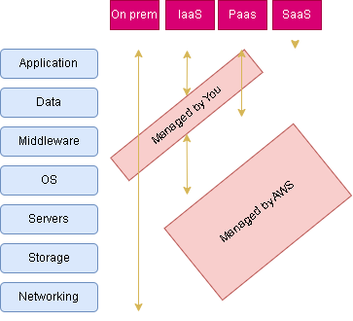
Types of Cloud computing

Slide 11
AWS Terminologies
AWS is truly global , global presence everywhere
AWS Regions
A single AWS region is cluster of datacenters
US East (N. Virginia) us-east-1 → Mostly called us-east-1 region
Asia Pacific (Mumbai) ap-south-1 -> Mostly called ap-south-1 region
Choice of region depends on various factors -
Compliance – legal , that data should never leave regions
Latency – Say most users are in Australia, so deploy application in Australia
Availability of Services – Not all region has all AWS services
Pricing – Varies from region to region

Slide 12
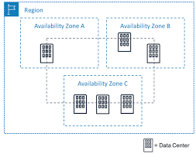
AWS Terminologies
AWS Availability Zones (AZs)
A single AZ is one or more discrete data centers with its own power and networking and connectivity
Each region got multiple AZs ( min 3, max 6)
Each AZ is isolated from each other, to take care of
disaster
In Mumbai , we have 3 AZs, physically isolated from
each other
The AZs are connected with high bandwidth and low
latency network

Slide 13
AWS Console
KEEP TRACK ON YOUR BILLING DASHBOARD, ALWAYS
Click on your Account ID, to get billing details

Slide 14
EC2

Slide 15
Amazon Elastic compute cloud – ec2
Most popular services
What is it ?
VM (EC2)
Virtual drives (EBS)
Load balancer (ELB)
Scaling (ASG)
Not to worry, we will see everything
Bootstrapping – Launching commands when machine starts, script which run once when instance is starting first time and never again – will be useful latter
There are different types of ec2 instances choices varies in terms of cpu, ram, storage, network performance
For demo purpose , we will be using t2.micro, is part of free tier (upto 750 hours /month)

Slide 16
EC2 – IP Address notations
IP address can be 10.0.0.0, and each number separated by dot is 8 bit (8+8+8+8)
So, IP Address is of 32 bits
On cloud, the IP address range will be represented by a slash (/) notation (10.0.0.0/16)
The number after / notation indicate how many addresses are network address (fixed) and how many remaining can be assigned to devices within that IP Range
Consider 10.0.0.0/24
24 indicates that 8+8+8 are fixed (network range) and only last 8 bits can be assigned – 10.0.0.1 -> 10.0.0.254 (1 or few are reserved , so last digit is 254)
No of Ips = 2 ⁽³²⁻²⁴⁾ = 2⁸ ⁼ 256 IPs
Consider 10.0.0.0/16
16 indicates that 8+8 are fixed (network range) and only last 2, 8 bits can be assigned – 10.0.0.1 -> 10.0.255.254
No of Ips = 2 ⁽³²⁻¹⁶⁾ = 2¹⁶ ⁼ 65536
Consider 0.0.0.0/0
0 bits are fixed, and this range includes all possible IP addresses

Slide 17
EC2 – Hands on
Let’s create EC2 Instance with all defaults in Mumbai (or N Virginia) - (Can be created from search -> EC2)
Lots of flavors to select from, Amazon Linux, Ubuntu , macOS etc.,
Instance type – Select one from free tier
Key Pair – To Login to system (select putty type .ppk). Gets downloaded.
VPC – Virtual Private Cloud, resembles traditional network setup in your own office or data center
Subnet – VPC can be divided in sub networks with fewer IP ranges from VPC. Such individual sub network is termed as Subnet, in which resource can be launched
Public IP – Using which a resource can be accessed publicly
Firewall Security rules – Security groups represent such rules and can define protocol, port as well as who can access the EC2
Storage – Elastic Block Storage (EBS) , for storage attached to EC2
Launch Instance and access with key downloaded and user ec2-user
wget google.co.in, will download a index.html, indicates it has access to outside world
After your operations better to delete the instance

Slide 18
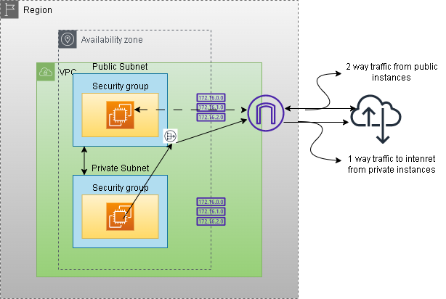
EC2 Traffic flow – Architecture

Slide 19
EC2 – Hands on from scratch
Let’s create everything involved in creation of EC2 instance
VPC (Can be created from search -> VPC)
IPv4 CIDR - 10.0.0.0/16 -> The ec2 instances withing this VPC will get a IP address from this range
A default route table is created
A route table contains a set of rules, called routes, that determine where network traffic from your subnet or gateway is directed
Subnet (Can be created from search -> VPC)
IPv4 CIDR - 10.0.0.0/24 -> cl-public-subnet-1 (should not get overlap) (accessible from internet)
IPv4 CIDR - 10.0.1.0/24 -> cl-public-subnet-2 (accessible from internet)
IPv4 CIDR - 10.0.2.0/24 -> cl-private-subnet-1 (no access from internet)
IPv4 CIDR - 10.0.3.0/24 -> cl-private-subnet-2 (no access from internet)
Subnets are labelled with private or public but at moment they are all private by default
IPv4 CIDR(24 means first 3 bits are fixed) | From | To
10.0.0.0/24 | 10.0.0.0 | 10.0.0.254
10.0.1.0/24 | 10.0.1.0 | 10.0.1.254
10.0.2.0/24 | 10.0.2.0 | 10.0.2.254
10.0.3.0/24 | 10.0.3.0 | 10.0.3.254

Slide 20
EC2 – Hands on from scratch
Route table (Can be created from search -> VPC)
With VPC, there is a default route table created.
Route table is responsible for how traffic is routed inside that of VPC (when a request is made to or from a device inside VPC)
Look at Routes (Rules) -> Destination is 10.0.0.0/16 and Target is local -> suggests, any traffic towards this destination should routed locally , like, if say traffic comes for one of the IP from destination ip range and say an ec2 instance within that VPC (will have IP from this range), then traffic should move to that ec2 instance
Every route table is also associated with subnets. Route table by default is associated with all the subnets, within that VPC. But an explicit association can be made
Now there is one rule, for VPC IP address range , where all subnets falls. So, all subnets know how to route traffic locally and can reach other. There is one rule for target local and not internet and hence all subnets are private (as of now)
These subnets can talk to each other and so all devices within that subnet can talk to each other

Slide 21
EC2 – Hands on from scratch
How to make subnets as public subnet
Internet Gateway (Can be created from search -> VPC)
Internet Gateway is device, attached to VPC and provides 2-way connectivity to the devices within that VPC or to be precise within subnets
We have one internet gateway for default VPC, lets create one for our demo VPC - cl-internet-gateway (and attach to our vpc) (Can be created from search -> VPC)
Also create a new route table – cl-route-table (so we have 2 route tables , 1 is default with vpc and another is this one) (Can be created from search -> VPC)
New route table need modification for non-internal traffic to internet gateway. Create rule to have destination as 0.0.0.0/0 (everything) and target as internet gateway
So, Internet gateway will now accept all requests and from internet and forward them to respective device
This route table now address both internal and internet traffic and should be associated with subnets which are supposed to be connected to the internet (Associate public subnets)
The private subnets are still left and should now be associated with default route table created with VPC
Default route table don’t have any route to internet and subnets associated with it are all private

Slide 22
EC2 – Hands on from scratch
Launch EC2 instance ((Can be created from search -> EC2)
Name - ec2-instance-in-public-subnet
Select created VPC and a public subnet
Enable public IP
Create security group (cl-sec-group) with 3 rules , SSH-22 , HTTP-80,
Put code/ec2-bootstrap.sh as bootstrap script
Create similar instance but in private subnet (ec2-instance-in-private-subnet), with same security group
Try to ssh private instance – Not allowed
Try to ssh public instance – Allowed
Try http://public_ip_of_public_instance - Allowed
Try http://public_ip_of_private_instance – Not Allowed
Try to ping private_ip_of_private_instance from public instance - Allowed, internal traffic

Slide 23
EC2 – Hands on from scratch
Nat Gateway (Can be created from search -> VPC)
To enable instance within private subnet to communicate with outside world – 1 Way
Would be needed to download security patches or updates
Nat gateway need to be launched in public subnet only, since systems should talk to internet
Allocate an elastic public IP (The IP which can be attached to any device, got limits/account)
It takes few min for nat gateway to be in state of ‘Available’ after its creation
Open puttyGen -> Load private Key -> From Menu -> Conversion -> Export Open SSH Key -> Save file with .pub extension
ssh to public instance and copy the .pub file (WinScp or any other tool can be used to copy) and chmod 400 .pub file
ssh to private IP of private instance from public instance (ssh –i **.pub ec2-user@private_ip_of_private_instance)
wget refiff.com -> Not allowed to connect to internet
Now attached nat gateway to default route table with 0.0.0.0/0 as destination and target as nat gateway
wget refiff.com -> Allowed as traffic routed from nat gatway

Slide 24
EC2 Traffic flow – Architecture - REVISIT
Don’t forget to delete things you created – EC2, NAT Gateway (wait till completion), Internet Gateway, Release Elastic IP, VPC, Security Group

Slide 25
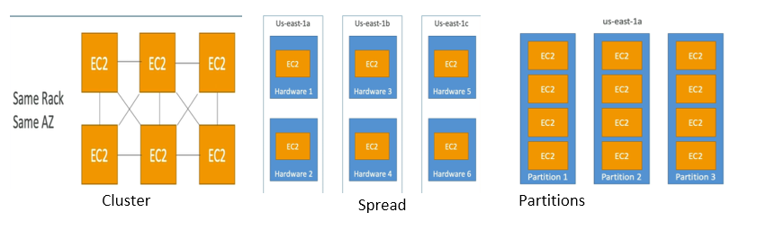
EC2 – Placement groups - no hands on
Control EC2 placement (Search for EC2 on console -> Left menu -> Placement groups
Group Strategies
Cluster – placed in single AZ, same rack, for low latency (If rack fails, all instances fail). Suitable for applications requiring extremely low network latency, like Big Data job that need to complete fast
Spread – spread across underlying hardware (each instance in its own distinct rack) , for critical applications not impacted by hardware failure.
Partition – spread instances across partitions – each partition represents a rack. If one rack fails that partition is failed but it's isolated from other partition, so if have replication in other partition your data will be safe suitable for replicated framework like Hadoop, Kafka
While creating EC2 instance , there will be placement group option in Advanced section

Slide 26
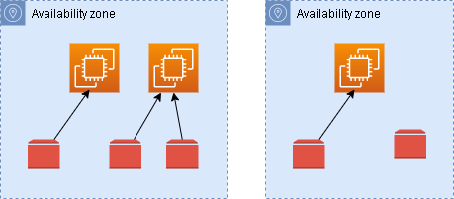
Elastic block storage - EBs
EBS is not physical drive
EBS is network drive and can be attached to EC2 instance
The communication to EC2 instance happens via network and is bit slow
1 EBS volume can be attached to 1 EC2 instance at a time, though 1 EC2 instance can have multiple EBS volumes attached
EBS is scoped to AZ. EBS created in 1 AZ can’t be attached to EC2 instance of another AZ
EBS volume can be preserved even after deletion of instance , can be seen in storage section of EC2 instance (Storage section while launching EC2 -> Advanced -> Delete on Termination)
EBS volume can be provisioned and remain unattached. Can be attached on demand (EC2 -> Volumes -> Create Volume)
EBS volumes are charged above free tier, based on provisioned capacity and IOPs

Slide 27
EBS – hands-on
Provision a EC2 instance
EC2 instance -> Elastic Block Store -> Volume can be seen
Delete EC2 instance and see that root volume is gone
Provision another EC2 instance but this time, under Configure Storage Section -> Advance -> Set Delete on termination to No
Delete EC2 instance and see that root volume is preserved

Slide 28
EBS –Attach vol - hands-on
Provision a EC2 instance, say ec2-ebs-1
EC2 instance -> Elastic Block Store -> Volume can be seen, lets name this volume as ec2-ebs-vol-1
Login to EC2 (ec2-ebs-1) and create a file with some content on /home/ec2-user directory
Stop the EC2 instance and detach the volume when instance is stopped completely, (Vol -> Action -> Detach Volume)(Ensure Attached resources on vol is blank)
Provision another EC2 instance, say ec2-ebs-2
When instance is in Running state, attach the previous vol , i.e., vol-1 , to this ec2-instance ec2-ebs-2 (Vol -> Select ec2-ebs-vol-1 -> Action ->Attach Volume -> select newly created ec2 -> select any device name)
On EC2 -> Storage , vol attachment can be confirmed
Login to ec2-ebs-2
Print all block devices by command lsblk, can see newly attach volume now
Check file system type by command lsblk –f , mostly file system would be xfs (High Performance scalable file system) (There are some other types like EXT4)
Let’s mount this file system – run following commands
sudo mkdir /mnt/old_machine
sudo mount /dev/xvdb1 /mnt/old_machine/ -t xfs (If this gives error, debug by following command)
sudo dmesg | tail (might indicate duplicate UUID error, to ignore check , run following)
sudo mount –o nouuid /dev/xvdb1 /mnt/old_machine/ -t xfs
cd /mnt/old_machine/home/ec2-user (and verify previous file)
Don’t forget to terminate EC2 instances and volumes created

Slide 29
EBS Snapshots
EBS Snapshots are a point-in-time copy of your data, and can be used to enable disaster recovery, migrate data across regions and accounts
Incremental – only backup changed blocks
Stored on S3 to which user don’t have access
The snapshots can be taken when volume is attached to EC2 instance but recommended to detach it (not root)
The snapshot can be copied across AZs and Regions and then can be restored to EBS volume in another AZ or Region, to attach to EC2 instance there
Thus, the data can be transferred to another AZ or regions. Useful for Disaster Recovery

Slide 30
EBS Snapshots – HANDS on
Create EC2 instance, say ec2-ebs-ss-1, with storage configured as Delete on Termination set to No
EC2 instance -> Volume can be seen, lets name this volume as ec2-ebs-ss-vol-1
Once instance is in Running state, login and create one file with some content
Terminate instance, but vol can be seen, because Delete on Terminate is No
Volume -> Action -> Create Snapshots, say ec2-ebs-ss-1
Wait for snapshot to be in ‘Available’ state
Delete the volume now
EC2 -> Snapshots and list snapshot ec2-ebs-ss-1
Action - > Create Vol from Snapshot (keep all default values, for all fields) (Select/Note AZ while creating volume)
Name this volume as ec2-ebs-ss-vol-2
Create another EC2 instance, in same AZ as volume, say ec2-ebs-ss-2 and wait for it to be in Running state
Attach newly created volume, i.e., ec2-ebs-ss-vol-2, to new ec2 instance i.e., ec2-ebs-ss-2
Follow same process, as we did on previous Hands on to mount volume and see , previously created data (file)
Also copy snapshots to other region, create volumes from snapshots in other region, create ec2, attach volume and see the data in other regions
Don’t forget to terminate EC2 instances and snapshots and volumes created

Slide 31
AMI – Amazon machine image
Machine image is like a blueprint of machine, from which machine, specifically ec2 instances can be recreated
When you create ec2 instances , you are already creating those from images
You can customize ec2 instance and can image it and save it, to latter creating ec2 instances from it
The image can again be transferred across regions
Hand-ON
Create an ec2 instance, with user data bootstrapping by only installing Apache Server (ignoring last line from code/ec2-bootstrap.sh)
Wait for ec2 instance to be in running state and then launch public IP. It will display home page of Apache or a massage displaying – ‘It works!’ (can take bit of time)
Select ec2 instance -> Action -> Image and templates -> Create Image
On left Menu -> AMI and AMI will be listed. Wait for status to be in ‘Available’. Then Launch instance from AMI. While launching paste the first and last line from code/ec2-bootstrap.sh (#!/bin/bash and last line)
After ec2 comes in Running state, launch public IP in browser and see the index page. The apache server installation was available on AMI, and we didn’t install it on ec2

Slide 32
Instance store (no hands-on)
EBS is network storage and has limited performance
For high performance, we need physical storage (hardware disk) , attached to ec2 (very high IOPs)
Such hardware disks are available with AWS, and can be attached to instance (mostly ec2 flavors comes with instance storage) (Launch Instance -> Select AMI -> Community AMI -> on left menu choose Root Device type as Instance Store)
These deliver better I/O , throughput, better performance
But they are ephemeral in nature and data is lost when instance is stopped (but is retained when instance is rebooted)
These are good for caching , huge computations which require temp space , buffer
Its user responsibility to back it up and replicate
In case EC2 instance fails, there would be data loss

Slide 33
Scalability
Ability to handle more load , 2 types of scalability on cloud -
Vertical – Increase size of instance, like from t2.micro to t2.large
Most common in use cases like older generation databases, which were kind of operating from one machine
But there is limit to which a hardware can scale
Horizontal – Instead of size, the number of instances are increased.
This is more common for modern applications and super easy to achieve on AWS.
Horizontal scaling is also called as elasticity, but elasticity is more towards auto scaling based on load. It can scale out and scaled in as well based on load

Slide 34
High availability
This means application is available maximum time and downtime is very less or none
This goes hands-in-hands with horizontal scaling
For AWS, application is deployed and running across multiple AZs
So even if one AZ is down (due to say power-cut or natural disaster), application would continue to serve from another AZ

Slide 35
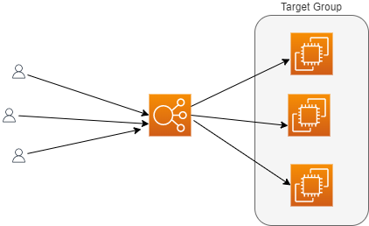
Load balancing
Load balancer forward traffic to multiple downstream ec2 instance
Based on load of ec2 instance (and also on other factors) , load balancer chose which ec2 instance can serve further request
The application would be accessed by single domain of load balancer, though traffic is served by multiple downstream ec2 instances
Imagine an ec2 instance is down, the load balancer would take out that instance out of service and application would continue to serve from other healthy instances
Load balancer can provide SSL termination
Even load balancer can be deployed in multi-AZ mode, to make application highly available
Managed by AWS, all its maintenance, upgrades
4 types of Load Balancer – Can be explained latter

Slide 36
ALB – Hands on
Create 2 ec2 instances, in same VPC, with user data script and verify the webpage on accessing public IP of instances
Create an application load balancer – steps below
Search Load Balancer -> Create LB -> Application LB, Create
Put Name, select scheme as Internet facing, select VPC same as your EC2 instances and select AZ. Ensure you selecting all AZs, where EC2 instances are launched
On security group of ALB, only allow http traffic, from anywhere (create new security group, in same VPC)
Create target group with target type as Instances, with protocol port as http 80, IP address type as IPv4, same VPC, protocol version HTTP1, rest all default values and click Next.
On Register target page , refresh instances and select 2 EC2 instances created earlier. Keep port as 80 and click on Include as Pending and then click on Create target group
The status of target group would be unhealthy and Unused.
Back on LB page, refresh target group and select the target group created. Keep everything default and click on Create LB button. Status would be provisioning and would take some time to become Active
Once in Active state, hit the DNS name of ALB on browser and see traffic moving from one ec2 to another
Check target group and both ec2 will be healthy
Stop one instance and it will be unhealthy on target group
Now ALB will send request to healthy instance only
If stopped instances is started again, the traffic would again resume normally to both instances from ALB
Delete everything

Slide 37
Auto scaling group (ASG)
Auto scaling deals with horizontal scaling of ec2 servers on the backend.
It makes EC2 instances grow or reduced based on the load
It ensures max and min capacity based on load
Cost savings as we always run with optimal capacity
This works hand in hand with ALB. As instances are added or reduced from ASG, the instances are either registered or deregistered with ALB
PRE- REQ FOR Lab
Either use VPC and more option to create VPC, Subnets, RT, NG , IG Or follow following steps -
For default VPC there are 6 subnets
There is already a route table attached to internet gateway and all 6 subnet are public
Create one more route table, nat-gateway and put route for nat-gateway in this route table
Out of 6 subnet , change route for 3 subnets to direct traffic from internet-gateway to nat-gateway
Thus 3 subnets will be public and 3 will be private. Name the subnets accordingly
Ensure, the subnet association to respective route table. Public subnets should be associated with route table having route for internet gateway and Private subnets should be associated with route table having route to nat-gateway
Also, under VPC , edit all Subnets and uncheck ‘Enable auto-assign public IPv4 address’

Slide 38
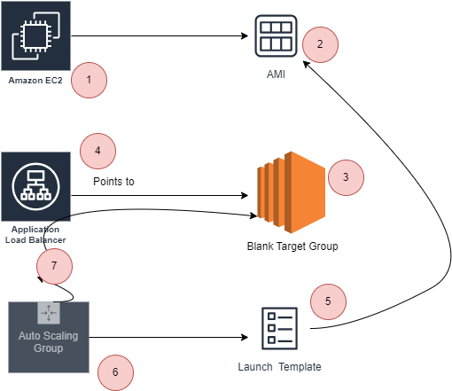
Steps - Auto scaling group (ASG)
Launch template decide how to launch EC2 instance like what size, what content etc.,
ASG decide how many instance to launch (desired, max)

Slide 39
ASG Hands-on
Create a EC2 instance, in public subnet, with bootstrap script (except last line) with SG allowing ssh , http, https. Ensure Apache is working and then create AMI from that instance and terminate the instance
Create a Security group with http and ssh allowed
Create a target group with no instances and security group allowing http:80 from anywhere
Create an ALB with target group and security group created (http , ssh)
Will create ASG. First let’s create launch template with AMI created above and also instance type as t2.micro. Select Key Pair, and no Subnet is needed. Select SG with http, ssh. Put user data bootstrap script with ec2 (only first and last line) .
Launch template determine how the ec2 instances should be created.
Back to ASG , attach this launch template . Select VPC and public subnets say in us-east-1 region – See notes
Select existing LB with target group and select the target group we created
For health checks select both EC2 and ALB, reduce time of ALB health check to 60s
Put desired capacity as 2 and max desired capacity as 5
Once ASG is created, you should be able to see 2 instances (desired capacity on EC2 dashboard)
On ASG , under activities tabs , activities are listed
Under Instance mgmt. tabs , instances can be seen (healthy)
Hitting ALB DNS will show response
Try deleting one ec2 and another will come up in some time automatically (desired capacity is 2) (health check is 60s, need to wait for 1-2 min)
Delete ALB , ASG, Target group, Launch Template
Notes:
While launching ALB , you need to select Subnets. You need to select Public Subnets, so that the ALB is accessible from Internet
Also, In ASG , you can select private subnets, to launch EC2 instances (Subnets should be associated with NAT Gateway then). If you do so, then in ALB , you need to select those private subnets in which EC2 instances (selected in ASG) are launched(for ALB to connect with EC2 instances), along with public subnets (for ALB to be accessible via Internet)

Slide 40
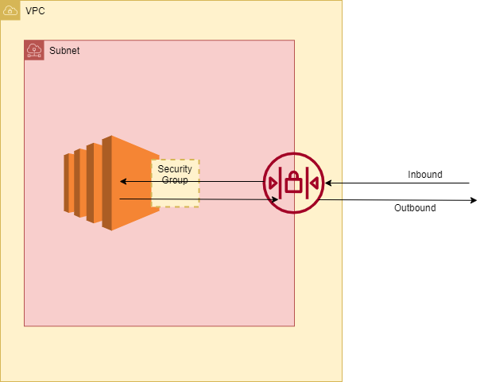
Security group vs Network access control list (NACL) – hands on
Notes:
To turn on the connection to a service running on an instance, the associated network ACL must allow the following:
Inbound traffic on the port that the service is listening on
Outbound traffic to ephemeral ports
When a client connects to a server, a random port from the ephemeral port range (1024-65535) becomes the client's source port.
The designated ephemeral port becomes the destination port for return traffic from the service. Outbound traffic to the ephemeral port must be allowed in the network ACL.

Slide 41
Security group vs Network access control list (NACL) – hands on
Create VPC and more, having 1 nat gateway
Create a EC2 instance, in public subnet, with SG rules allowing ssh, http, and bootstrap script to have apache and web page.
Once instance is in Running state, ensure Apache display web page
Go to Security group of EC2 instance
Security group is layer of defense and works at instance level (Instance doesn’t mean EC2 only , it can be anything like Databases, Kafka or any service on AWS)
It controls traffic to and from AWS service
Inbound will show rules (ssh, , http) allowed and outbound will show everything allowed
On outbound, rules, change the default rule to allow only ssh. And access the web page. Its accessible.
This suggest, security group allow outbound traffic, based on inbound traffic. If inbound traffic is allowed, the outbound is automatically allowed. This nature is called as Stateful i.e., Security Groups are stateful in nature
Click on Subnet of EC2 instance, check the NACL.
NACL is first layer of defense, and it governs traffic at Subnet level. Everything inside subnet, will have to pass through NACL. Security group is 2nd layer of defense.
Over NACL there is option to Deny, so traffic can be denied, but for Security Group, there is no Deny option. It only Allows traffic
Now change the NACL. Add a rule with number 95, allowing HTTP(80) traffic on Inbound and “All TCP” in outbound (We don’t know what port the Http response would go) See Notes
Try to access EC2 website now, accessible
Edit NACL Inbound rule, and put HTTP(80), as Deny
Try to access EC2 website now, not accessible – The HTTP(80) traffic is now denied at subnet layer itself, traffic won’t even reach to EC2
Notes:
To turn on the connection to a service running on an instance, the associated network ACL must allow the following:
Inbound traffic on the port that the service is listening on
Outbound traffic to ephemeral ports
When a client connects to a server, a random port from the ephemeral port range (1024-65535) becomes the client's source port.
The designated ephemeral port becomes the destination port for return traffic from the service. Outbound traffic to the ephemeral port must be allowed in the network ACL.

Slide 42
Security group vs Network access control list (NACL) – hands on
The traffic is allowed or Denies at NACL first and then at Security Group
Change the NACL rule back to Allow On Inbound and try to access instance webpage. Now webpage will be accessible
Change the outbound rule Deny All TCP and try accessing web page , not accessible
NACL is stateless in nature, it doesn’t track request to allow response
NACL has numbers mentioned for rules, lowest of that number will have highest priority. * is evaluated at end
Say at 95 some xyz traffic is Denied and at 100 same traffic is Allowed. 95 number rule will be evaluated first and effectively the xyz traffic would be Denied
Change NACL Inbound Rule, to Deny HTTP(80) , try accessing webpage , not accessible
Change number of Inbound rule for HTTP(80) from 95 rule to 105 , try accessing webpage , now accessible
The rules on NACL are prioritized as per their number, lowest one get highest priority. Once allowed or denied, the rule after that won’t have any impact

Slide 43
IAM

Slide 44
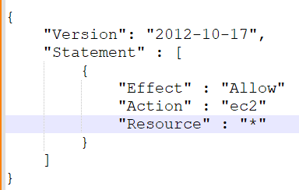
Identity access management – IAM
IAM is global service
Some part of it you are already using, like your account which is your root account
Never share root account, but create users for them to access AWS
Users can be grouped together, based on their roles, in groups
The users are assigned permissions by something called as policies
A policy is JSON doc, describing the resource and permissions on resource
User can exist without group or can belong to multiple group
In AWS, always apply principal of least privilege, i.e., never allow permissions more than needed

Slide 45
IAM – Hands on
Search IAM and click on that
You can see on top that this is global service
Add User, Provide user access to the AWS Management Console, I want to create an IAM user, don’t force to change password on next login, Add User to a Group, Create Group, Assign Administrator Access Policy
Once created, explore Groups and Users from left menu
Click on Dashboard and on right, Create Account Alias
Copy Sign-in URL and open in Firefox private window and sign in
Can do anything since this is Admin user
Click on the name on right top and along with account id now IAM user label would be visible, indicating IAM user and not root account

Slide 46
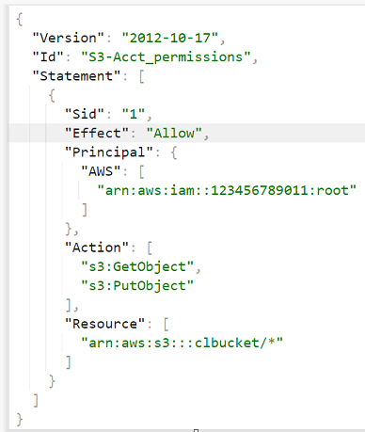
IAM policies
If a policy is applied to a group, it is inherited by all members of that group
A policy structure is like shown in picture
Id is id of policy , optional
Sid is statement Id , optional
Effect can be allowing actions or deny action
Actions are what actions are allowed on Resource, which is
S3 bucket ARN in this case
Principal is who can perform (or cannot perform), these actions,
in this case, root account
Login to account with root user and see policy for role AdministratorAccess

Slide 47
IAM Roles
AWS services might need to perform actions on your behalf
Like say you are creating some AWS database which will be storing data on S3. So here a AWS service which is database would need access to S3
In this case, permissions to database to access S3, are assigned via AWS Roles
The IAM roles will be demonstrated throughout the course, here onwards

Slide 48
S3

Slide 49

Simple storage service – s3
Infinitely scaling object storage
Many applications, web-sites uses S3 as their backend storage.
Lot of AWS services are also integrated with S3
S3 can be used for
Backups, disaster recovery
Archive
On prem storage can be extended to cloud using S3
Storing Images, Videos and all media files
Hosting static websites
Big data
Amazon S3 stores files in buckets (top level directories)
Files are called as objects
S3 services is global service. The buckets created are accessible across all regions of a geo
But bucket itself is regional resource
Objects can be nested like directories. There are no directories there, but UI will look like

Slide 50
S3 – hands on
Try to create bucket with name mybucket, will show error about name, should be globally unique
Chose region close to you
Keep everything default, and create bucket
Upload an image , keep everything else default
Click on image name, to see details
Copy object URL and try opening in another browser tab, access denied
Click on Open button, image will be visible. The URL here is having my encoded signature in URL and hence access is granted
Create folder, everything else default
Can upload image inside folder
Delete the objects

Slide 51
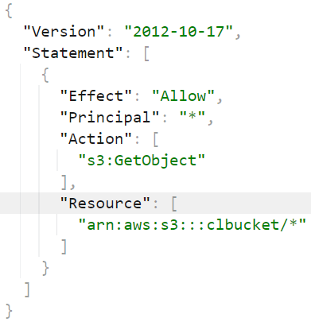
S3 – Security
Access to the S3 can be via IAM Policies, assigned to user, as to which API call is allowed for that user
Or can be via Resource based policies, attached to bucket itself and to what actions are allowed on that bucket
So S3 can be assessed if IAM permission allows it or S3 bucket itself allows that
This policy allows getting object on S3, for all the objects on mentioned bucket
to everyone (Principal is *)
Setting public read on all objects, inside that bucket

Slide 52
S3 – policies
The bucket we created was not accessible via URL
Click on bucket -> Permissions :: Uncheck block public access
:: Edit bucket Policy :: Policy generator :: -> Actions = GetObject and ARN = <bucket_arn>/* , Principal should be *
:: Add Statement :: Generate Policy :: Copy that in bucket policy and Save
Try image via URL , can be accessed now.
So, objects are accessible via public URLs
The policy is having GetObject permission. This is for other users/public access
Being owner of bucket, I would be able to put or get objects. This policy won’t impact owner at this point

Slide 53
S3 – IAM Role
Create a EC2 instance (in public subnet and without key)
Connect via EC2 instance Connect, once instance is in Running state
Try aws s3 ls – Error about not configured (don’t configure anything)
Create a IAM role with policy AmazonS3ReadOnlyAccess
Attach that to instance (Action -> Security -> Modify IAM Role)
And now run aws s3 ls –> things will be accessible
Try making bucket - aws s3 mb s3://buk0617 -> Access denied
Create a role with policy S3 full access
Attach that to instance
Now try aws s3 mb s3://buk0617
aws s3 rb s3://buk0617

Slide 54
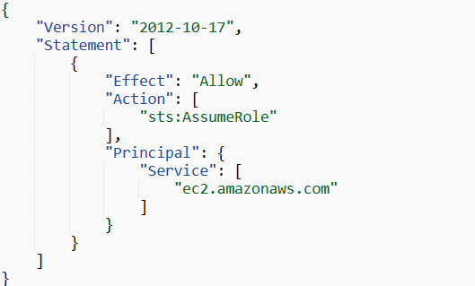
IAM Role – Trust Relationship
Last hands on, EC2 was allowed to get S3 objects with a IAM Role
IAM role has policy(/policies) would govern specific permissions/action on AWS resource (S3 in last case)
There is something called as trust relationship (shown snippet)
Trust relation specify trusted entities or services that are allowed to assume that role (can be IAM User, IAM Role, AWS Service or some user from different AWS account)
Following trust policy, indicates, service – ec2 , will assume role to do operations, specified in policies (in last case it was get object from S3)

Slide 55
S3 – Static websites
S3 can host static websites and have them accessible over internet (not dynamic websites)
Create a bucket and add index.html and aws.png, from code folder
Buckets should be public – uncheck ‘Block all public access’ and also add policy for public access. Generate policy via policy generator for ‘GetObject’ and ARN appended with /* (sample policy is in Notes)
:: Properties :: Static Web Site Hosting :: Enable :: Index Document -> Index.html -> Save
:: Properties :: Static Web Site Hosting :: -> Copy URL and Open in browser window
Notes:
{
"Version": "2012-10-17",
"Id": "Policy1703230336135",
"Statement": [
{
"Sid": "Stmt1703230335218",
"Effect": "Allow",
"Principal": "*",
"Action": "s3:GetObject",
"Resource": "arn:aws:s3:::static-bucket0617/*"
}
]
}

Slide 56
S3 – versioning
In case of overwrite an object, better to enable versioning at bucket level
Its helps rollback to previous versions
It helps to recover from unintended deletes
All files before versioning will have version as null
:: Properties :: Versioning :: -> Enable
Open static website URL on a browser tab
Upload one more aws image from code/aws_another_logo folder
Refresh static website url and notice the changes
Object :: toggle on Show Versions, to see versions
For Rollback -> Select latest version of index.html and Delete
Refresh static website url and notice the changes
Delete Markers
When versioning is enabled, the delete of an object won’t delete it permanently, it would just mark that object for deletion with a delete marker
Say, if in case needed, the delete marker can be deleted to retrieve deleted objects with versions
Ensure you have multiple versions of say aws.png. Collapse show version and then delete aws.png. Now enable show versions, again after deletion, to see delete markers. The delete marker itself can be deleted now, to retrieve deleted object with versions

Slide 57
S3 – Replication
Say a bucket in one region need to be replicated to another region, asynchronously
Versioning must be enabled in both buckets
Replication can be in same region or different and can also be in same account or across
This case be for having a test environment or also for access s3 with lower latency
Create new bucket , say in same region, with versioning enabled
On origin bucket :: Management :: Create replication rule :: For Source bucket -> Apply to all object , then chose destination bucket. IAM Role -> Create a new role (to access destination bucket for read/write) Save
Prompt for replicate existing object, this is different to replication and existing objects would be replicated via a batch job , say No
Upload a file and see it getting replicated in destination bucket (might take 2-3 min)
Versions will match for replicated objects

Slide 58
S3 – storage classes
Saving and accessing objects from S3 are charged
So based on your storage and access requirements there are different storage classes for S3
S3 storage class
Amazon S3 standard–General purpose | For frequently access data gaming application
Amazon S3–Infrequent access | Data for less frequently accessed but require instant access when needed Lower cost for storage than standard but bit high for access Backup, Disaster Recovery
Amazon S3 One Zone–Infrequent access | Same as above but withing one zone , access cost will be slight lower than above one Secondary backup of data or data which can be easily recreated, since data would loss with loss of AZ
Amazon S3 Glacier Instant retrieval | Lost cost object storage, access cost bit higher. Data is accessible within mill seconds Min storage duration - 90 days
Amazon S3 Glacier Flexible retrieval | 1-5 min, 3-5 hours, 5-12 hours , less duration more cost of access Min storage duration - 90 days
Amazon S3 Glacier Deep Archive | For long term storage, like compliance to store data for specific number of years 12 hours and 48 hours retrieval Min storage duration - 180 days
Amazon S3 Glacier Intelligent tiering | Objects are automatically moved between classes based on usage patterns Object not accessed for 30 days moved to Infrequent Access Tier Objects not accessed for 90 days moves to Archive Access Tier and so on

Slide 59
S3 storage classes - hands on
Try creating bucket
Try Uploading Object :: While uploading :: Properties :: Various Storage classes to chose from
Upload object
Click on object :: Properties :: Edit , can change storage class
Bucket :: Management :: Lifecyle Rules :: Create Lifecycle Rule -> Apply to all objects , Move current versions of objects between storage classes
Can create rules like –
Standard-IA | 30
Intelligent Tiering | 60
Glacier Deep Archive | 180

Slide 60
S3 – Encryption – NO HANDS ON
All objects within buckets are encrypted by default for security purpose. This is called server side encryption
User can also encrypt before uploading object
Bucket :: Properties :: Encryption

Slide 61
Other compute services

Slide 62

AWS Lambda – truly serverless
EC2 | Lambda
Virtual Servers | Virtual functions
Boundaries are RAM and Memory | Short term execution
Continuously running and if not in free tier, will be charged for the time it is running | Run on demand, only when needed. Charged only when running
Scaling is with ASG, based on metrics or otherwise | Scaling is automatic
 | Free Tier includes 10,00000 AWS lambda request/month and then 20 cents / 10,0000 requests thereafter. Very cheap
 | Integrated with lot AWS services
 | Event Driven - Lambdas are invoked on some events
 | Can be written in many programming languages, Nodejs, Python, Java, C#, Golang, Ruby and others

Slide 63
lambda – hands on
On Lambda Home, Run button can be clicked to see lambda running – see Notes
Also, there is button – Lambda responds to event, which shows power of serverless lambda getting invoked in events
Create a node js lambda. To test we would need event. Test it
No need to manage an servers. We don’t even know where node js was deployed
Edit Configuration , Options are memory , timeout and role created by lambda
Monitor tab will show some useful metrics like how many times it was invoked, duration to execute and others
Create a bucket, demo-for-lambda
Create a nodejs lambda, with default role, with code at code/lambda_int_s3_code.js file (ensure region for s3 client, in code)(ensure to make some changes, and deploy lambda function) (a basic lambda role , with permission to cloudwatch would be created)(see Notes)
Create a trigger from Configuration tab of lamba , for S3 Object events. Configuration -> Add Trigger -> S3 - > for all objects events
Upload code/sample.json in S3
Observe logs from Cloudwatch, will show access denied error
Create a policy , to allow access from lambda to s3 and CloudWatch – (available at code/lambda_s3_policy.txt) and then create role from this policy (Or create inline policy onto same role, attached to lambda)
Lambda -> Configuration -> Permissions and change role to one crated above
Upload file again on s3 bucket and observe Cloudwatch logs again. This time it will be success.
Visit other options on Configuration tab
Notes:
The URL should look like (notie begin at end) – to get Lambda Run Screen
https://us-east-1.console.aws.amazon.com/lambda/home?region=us-east-1#/begin
Run -> Next: Lambda reponds to event
Then click on mobile or camera image to generate lots of events
Next: Scale seamlessly
Then click on mobile or camera image to generate lots of events , to see cost
================================================Lambda Role ====================================
AWSLambdaBasicExecutionRole-f9fda1cd-fc36-4466-99b8-810b9836136a
{ "Version": "2012-10-17", "Statement": [ { "Effect": "Allow", "Action": [ "logs:CreateLogGroup", "logs:CreateLogStream", "logs:PutLogEvents" ], "Resource": "*" } ]}

Slide 64
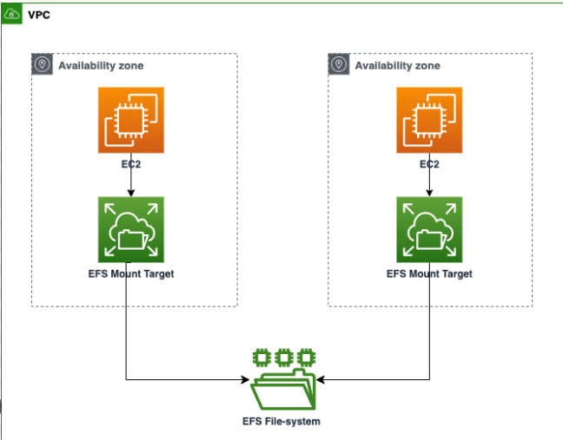
Elastic File System – serverless file storage
Elastic file system is managed Network File System (NFS), which can be mounted on many of EC2 instances
EFS is Shared network filesystem
EFS only works with linux
Instance from multi AZs can be attached to same EFS
Highly available and scalable, you don’t have to do capacity planning in advance, will scale as per need
All instances attached to a EFS can see same
files across
Follow notes for lab
Notes:
# Working with Files on EFS
## Launch EC2 instances
#### Ensure your public subnets got ‘Enable auto-assign public IPv4 address’ settings enabled. ####
#### AWS CLI can be referred at - https://awscli.amazonaws.com/v2/documentation/api/latest/reference/index.html ####
1. Create a security group (will get created in default VPC )
aws ec2 create-security-group --group-name chandra-sg-efs --description "chandra-sg-efs”
Copy SG Id - sg-0069491ad8193a4c3
2. Add a rule for SSH inbound to the security group
aws ec2 authorize-security-group-ingress --group-id sg-063da776c9bc097c7 --protocol tcp --port 22 --cidr 0.0.0.0/0
3. Add rule to the security group to allow the NFS protocol from group members
aws ec2 authorize-security-group-ingress --group-id sg-063da776c9bc097c7 --protocol tcp --port 2049 --source-group sg-063da776c9bc097c7
Suggest members of this SG will receive traffic on NFS port
View SG on AWS Console now
4. Launch instance in US-EAST-1A
aws ec2 run-instances --image-id ami-0dfcb1ef8550277af --instance-type t2.micro --placement AvailabilityZone=us-east-1a --security-group-ids sg-063da776c9bc097c7
5. Launch instance in US-EAST-1B
aws ec2 run-instances --image-id ami-0dfcb1ef8550277af --instance-type t2.micro --placement AvailabilityZone=us-east-1b --security-group-ids sg-063da776c9bc097c7
View EC2 on AWS Console now and ensure those in running state
## Create an EFS File System (on AWS Console)
Create an EFS file system , ensure same VPC as that of Instance and click on Customize option, mostly default option , click Next
Keep only us-east-1a and us-east-1b , remove default security group and put the one created above to allow NFS traffic
Create file System by clicking Next (…)
Click on EFS and On Network tab, the mount target id is displayed. Wait till those become Available
Copy DNS Name of fs (fs-05863d17abb40830e.efs.us-east-1.amazonaws.com)
## Mount using the NFS Client (perform steps on both instances)
1. Go to both EC2 instance, Connect, EC2 Instance Connect
2. Create an EFS mount point (run on both)
mkdir ~/efs-mount-point
3. Install NFS client (run on both)
sudo yum -y install nfs-utils
4. Mount using the EFS client (replace dns in below line) (on both instances)
sudo mount -t nfs4 -o nfsvers=4.1,rsize=1048576,wsize=1048576,hard,timeo=600,retrans=2,noresvport fs-05863d17abb40830e.efs.us-east-1.amazonaws.com:/ ~/efs-mount-point
5. Create a file on the file system, on 1 instance , by going inside efs-mount-point (cd efs-mount-point , sudo touch chandra.txt)
6. This file should be visible on other system
7. On one EC2 , run following commands
sudo su
echo "Hi Team" > chandra.txt
8. On other EC2 , cat chandra.txt -> changes should be visible
9. Delete EC2 , EFS, Security groups

Slide 65
Elastic container service - ecs
Elastic container service launch containers on AWS, without worrying about underlying infrastructure (no worry for installing docker, managing containers and all)
The infrastructure specification need to be specified by user, rest all will be taken care by AWS. (Like the OS , instance type need to be specified by user)
ECS can be created in 2 ways. One way is manual configurations, where used is responsible for creating ASG, specifying instance size, desired number of ec2 instances, volumes, networking and other things.
Other is serverless way, AWS Fargate, without having to manage servers or clusters of Amazon EC2 instances. User don’t specify anything.

Slide 66
ECS – Hands on WITH Fargate
Create a security group with ping and http traffic allowed
Create a role as directed at - https://docs.aws.amazon.com/AmazonECS/latest/developerguide/task_execution_IAM_role.html#create-task-execution-role
Try creating ECS cluster with Infrastructure as Fargate. (At this time, you can also select Infrastructure as EC2 along with Fargate, this will be useful while you want to deploy your task definition service as launch type EC2) (For this demo, we will use everything as serverless) (Selecting EC2 will give you options to select properties related to EC2 instances like OS , instance type, min and max numbers)(But select just AWS Fargate(serverless))
You can view progress in cloud formation template (will learn soon). ECS cluster will launch the containers as task. This require first a task definition which is blueprint for task to be deployed, on ECS.
After cluster, create new task definition with Launch type as Fargate. For Container Spec chose OS as Linux/X86_64, CPU as .25 vCPU and memory .5 GB. Keep Task role as blank and Task execution role as one we created above
Mention image as cbagade/cl-first-prog:v1, Container Port as 3000
Select task definition and Deploy as service. Select ECS cluster. Set Launch type as Fargate. Put service name and replica as 1. Under Networking section, select VPC , where security group above is created, keep only 2 public subnets and select security group created above. Public IP should be turned on.
Create Service and watch events in Cloud Formation stack. Wait till CFT events go in CREATE_COMPLETE state.
Cluster -> Tasks (click) -> copy public IP
To test image, hit http://<public_ip>:3000 on browser tab (This will fail. Modify SG created above , to allow Custom TCP traffic on port 3000) and then hit the URL again on browser
Delete the task definition and cluster (Can delete CFT stack)

Slide 67
Databases

Slide 68
AWS Databases
EBS, S3, EFS are technologies to store unstructured data
To store in structured way, there are databases. This will allow indexing and faster searching through data
The first kind of database which AWS offers is Relational Databases
One can establish links between tables and can use SQL Queries to perform operations on data
The other kind of database which AWS offers is NoSQL Database
Non relational database, build for modern applications
Flexible Schema, Scalable, High Performance
Examples – Mongo DB, Document DB, in-memory and so on
Data is always in JSON format
emp_id | emp_name | dept_id | emp_skills
1 | Sonia | 1 | Technical
2 | Vishal | 2 | Accounting
dept_id | dept_name
1 | Finance
2 | Cloud

Slide 69
Advantages of AWS Managed DB
Faster provisioning and available within few minutes to use
Highly Scalable and Available
AWS will take care of upgrade to db and OS patching
Monitoring, Logging, Alerting all can be configured

Slide 70
AWS RDS – Relational database service
AWS Managed DB service
Along with the advantages already mentioned, one can set up read replicas and also do multi-AZ setup
Following are the database engines, provided by RDS
Postgres
MYSQL
MariaDB
Oracle
Microsoft SQL Server
Along with these there is one more AWS proprietary kind RDS DB is Aurora
Aurora also comes with 2 flavors
Postgres (3x faster than RDS postgres)
MYSQL (5x faster than RDS MYSQL)
Aurora comes with auto growing storage (in chunks of 10 GB till 128 TB)
Bit more expensive than RDS, but AWS claims faster performance for Aurora

Slide 71
AWS RDS – Hands ON
Requires PGAdmin to access DB
Over RDS, Subnet Group. Create a subnet group with 2 public subnets
Over RDS, Create database, select Engine as Postgres (need to click on Postgres), Free Tier, Latest version, put Storage as 10GB, put password, Select subnet group created, Uncheck Enable Autoscaling, Enable Public Access, Create new Security Group, Port 5432, Turn off performance insight, Disable automated backups and Encryption
Let Status be Available, meanwhile change Security Group to put Source as Allow from anywhere for existing PostgreSQL rule and also add one more rule to allow All TCP traffic from anywhere (this is just for demo)
Meanwhile , also create a win instance with one of the subnet in which RDS is created and install PGAdmin on it
Once database is Available, Connectivity & Security -> Connected compute resource -> Setup EC2 connection and chose your EC2 win instance
Once database status is available , click on connect info and put in PGAdmin to see database
Over RDS, select database and Action, Take snapshot
Let the snapshot be available and try options as Action ->, Restore and Copy Snapshots
Restore will create new DB (no need to create), say with bigger capacity
Copy can copy snapshot across regions
Delete snapshot
Delete DB (don’t create final snapshot while deleting)
Delete security group

Slide 72
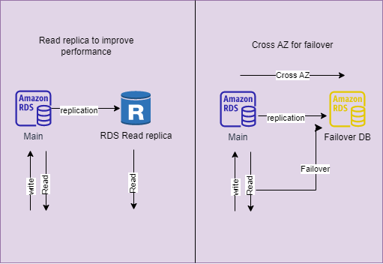
AWS RDS – Deployment types
Read replicas to improve read performance
Cross AZ replication for AZ failover
Same things can be setup across region for disaster recovery

Slide 73
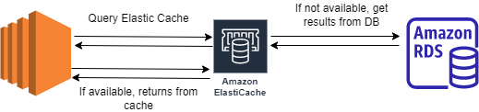
Elastic cache
Generally heavy query put lot of pressure on DB. Repeated execution of such query hampers DB performance
Caching is mechanism, to cache frequently used queries and return from cache
This improves DB performance
AWS got Elastic cache , in 2 flavors – Redis and Memcached
These are in-memory databases, with high performance and low latency, which helps reducing load on DB

Slide 74
Dynamo DB – serverless no SQLDB
Part of NoSQL family
Global service not in any VPC
Fully managed and replication is across 3 AZs
Serverless, no need to provision any server (database)
Single digit millisecond latency , extreme fast and scales to massive workloads
This is key-value database
DAX – Dynamo DB Accelerator is in-memory cache for DynamoDB (exclusively)
DAX improve performance 10x times

Slide 75
Dynamo DB – hands on
Create table, no need to create any database as this Is serverless
Say table name as articles. Give article_id as partition_key. Select Table as Customized Settings, DynamoDB standard as table class,
Read/Write capacity as On-demand (pay for actual read/write). Keep remaining things as is and Create table
Once Status is Active, Click on table and Create Items (Left hand menu is Explore Item)
While creating you can always input different attribute_name (no-sql db)
Delete table along with Cloud Watch Alarms
Create another table (shopping_cart) with partition_key as email_id and sort_key as created_at
Use default settings this time
Once table is available , create item. This time along with partition_key even sort key will contribute to uniqueness. Enter values as - 2023-12-29T13:30Z (add some attributes)
Try to create second item with same email id and same created_at. It will error out. Change created_at , it will success.

Slide 76
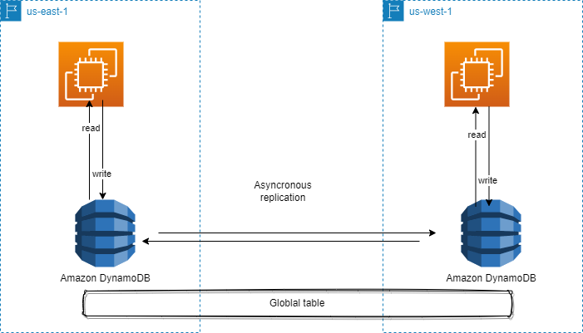
Dynamo DB Global table
When a table is made as global , same table is created in another region with read/write capacity
The data is replicated across, asynchronously
Its multi region, multi active database suggests, write can be performed on any table in any region and then data is replicated across other regions and also can be read from any region
Best for multi region deployment of an application where latency should be min or a Disaster recovery solution
(No Hands on) -> Click on table created earlier, over the tab ‘Global tables’ -> Create replica -> Choose region
Click on Create Replica button will create global table

Slide 77
Infrastructure

Slide 78
Cloud formation template - CFT
Deploy and manage infrastructure at scale
Declarative way to create infra, the infra need to be created via code and not manually
All the AWS resources can be created via CFT
The changes to code are tracked
CFT is smart enough to decide which resource need to be created in what order
A good documentation is available

Slide 79
Cft – hands on
Create stack and upload existing template file – code\ec2-template.yaml
CloudFormation -> Stack -> Create stack -> Chose an Existing Template -> Upload a template file -> upload code\ec2-template.yaml
On Next , give stack name. On Next, put all default and finally Submit
EC2 will be created in public subnet with public IP
Watch the events
Delete the stack to delete the instance
Reference stacks can be found out at –
https://docs.aws.amazon.com/AWSCloudFormation/latest/UserGuide/CHAP_TemplateQuickRef.html
Again, follow the same process to create stack with code\ec2-and-other-template.yaml
Delete the CFT to delete all resources
The previous stack can also be updated with the new template. Upload first template (code\ec2-template.yaml) and create stack. Once stack is created -
Change Set tab on existing Stack -> Create Change Set -> Replace current template -> Upload second template (code\ec2-and-other-template.yaml) and Next and final Submit
The next screen will show modification and addition of resources. Once Change Set status is Create Complete -> Execute Change Set -> Define behavior (keep all defaults) -> Click on Execute change set button
Events can be observed (Previous EC2 will be deleted and will get launched in new VPC/Subnet)
Delete the stack to delete all resources

Slide 80
Global applications
Global applications would be deployed in multi regions or at edge locations (close to users)
This produce decreased latency; things have less distance to travel towards users
Also helps in DR, in case one region goes down
Also ensure high availability, as presence of application is in across regions

Slide 81
Route-53
Route-53 is managed DNS service
Route-53 is collection of rules and records, which help client understand how to reach servers through URLs
Record types –
Domain | Mapped to | Record Type
chandra-learnings.com | 10.0.0.1 (IPv4) | A record
chandra-learnings.com | 2001:0dgb:85rg:0000:0000:6rg5:9876:3456 (IPv6) | AAAA record
chandra-learnings.com | search. chandra-learnings.com (another hostname) | CNAME record
chandra-learnings.com | ALB (AWS resource) | Alias record

Slide 82
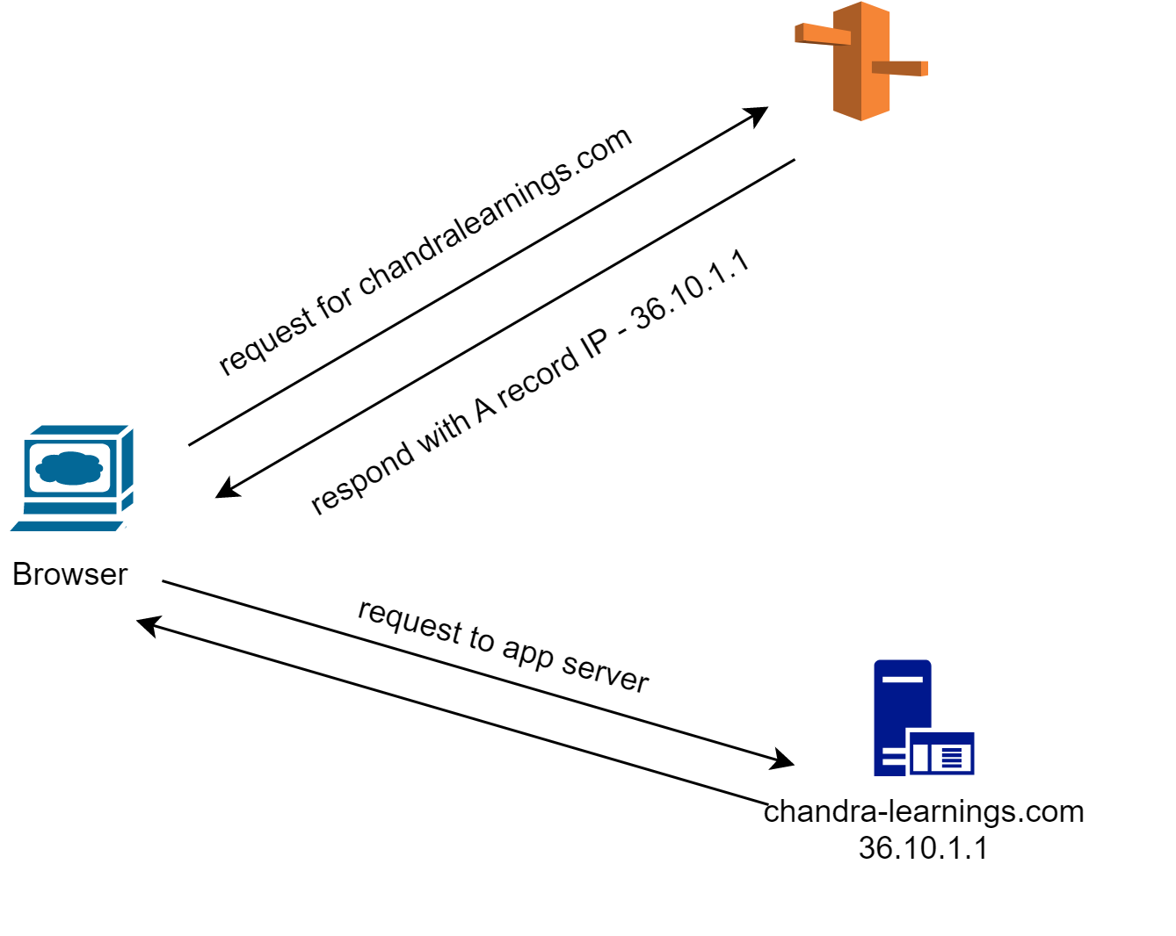
Route-53 working

Slide 83
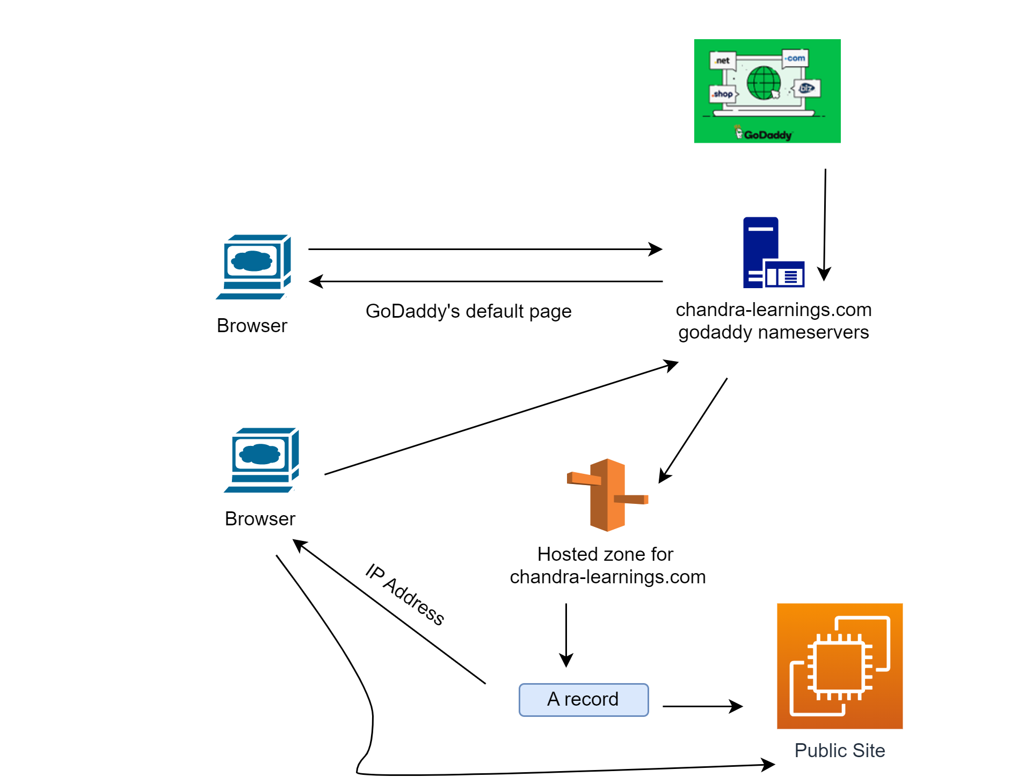
Route-53 demo
Notes:
-> Register domain on GoDaddy
Create hosted zone on Route-53 (like chandra-learnings.co.in)
Copy nameservers from NS record
-> Change Nameservers on GoDaddy to AWS ones (A min or 2 is required to reflect changes) (Ensure the NS changes with dig chandra-learnings.co.in on ubuntu)
-> Create EC2 instance with bootstrap script to have apache (No key is needed)
-> Ensure http://<public_ip_of_ec2> gives site
-> Create A record in Route53 as (test.<domain>) and value should be public IP of EC2
-> After some time, on Ubuntu -> dig test.chandra-learnings.co.in and see the IP address in result
-> After some time , hit http://test.<domain_name>
-> Should display site on EC2
Setup for Next Demo
--------------------------------------------
-> Create EC2 instance in diff region than earlier one with bootstrap script to have apache (No key is needed)
-> Setup a ALB with 1st instance (change region to original) (with SG allowing SSH and http)(select that of EC2)

Slide 84
ROUTE53 - concepts
ttl is time-to-live
The record will be cached till duration specified
Need to strike balance , too higher will show stale record , too low will hit Route53 and will incur charges
In test.<domain> record change ttl to 120 sec and put other IP (2nd instance, in diff region)
Do a dig and hit http call on browser, to test.<domain>, shows old record for 120s and after that it renews
CNAME record – allows to point hostname to another hostname
Like to alb hostname (dns name) (edit test.<domain> A record to make CNAME and put domain name of alb)
Do a dig and hit http call on browser, to test.<domain>, dig will show alb and its Ips
Change the test.<domain> record to CNAME and point to dns of alb
Alias record – allows to point to any other allowed AWS resource
Like again , can choose ALB (edit test.<domain> to make A record (from CNAME) and enabled Alias and chose ALB)
Lot of AWS resources can be selected as Alias
No change in results with dig or http call since same alb is used

Slide 85
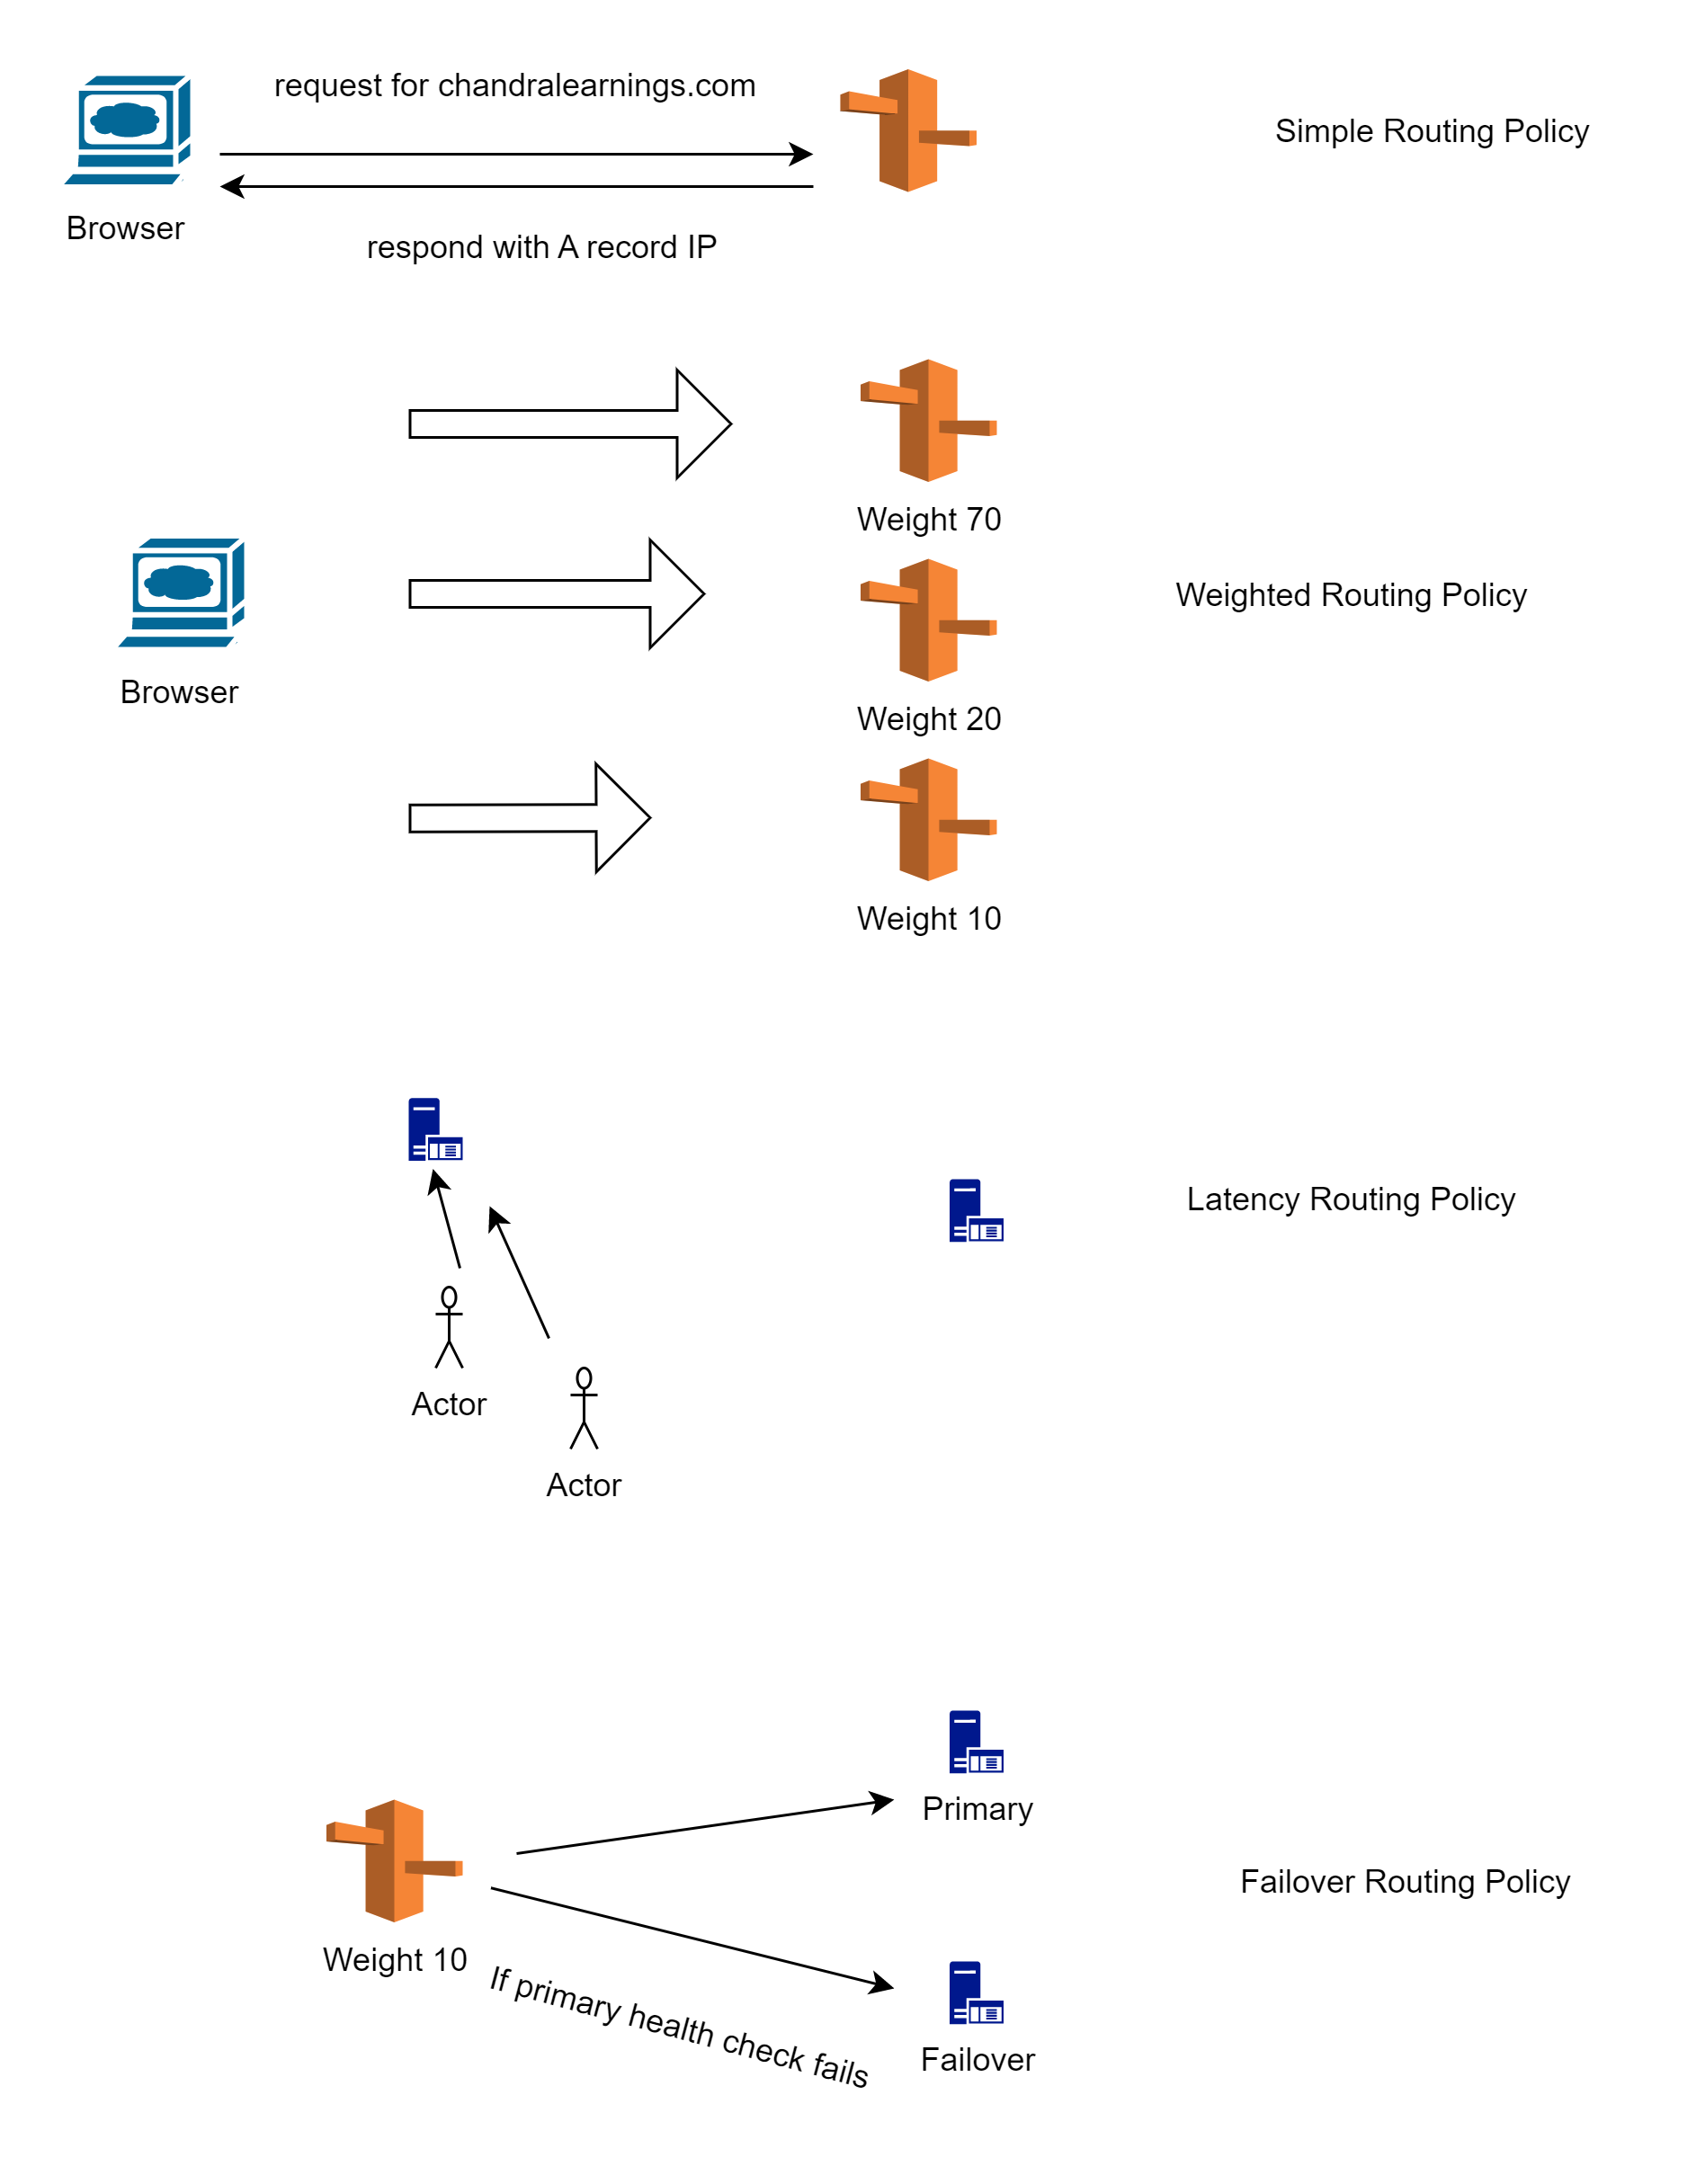
Route-53 policies
Notes:
Simple Routing -> Change test.<domain> record to A type. Put both Ips in box and set ttl to 30 Sec
Now dig will give 2 Ips and also hit on browser will give both results after ttl (try to clear cache if it doesn’t work)
Weighted -> Delete the test.<domain> record . Create another A record one with same test.<domain> and give 1st IP. Ttl – 5sec , routing policy as weighted and weight as 70. Give record id as any name like record-1
Add another record, same as previous one with 2nd IP and changes recorded.
Carrying on dig will return , high weighted record more time. Same with http call
Failover -> This would need a health check record. On route 53 , left menu , Health check. Create 1 for 1st IP and with till it becomes healthy
Create new record failover.<domain>. With ttl say 60 Sec and IP1 and routing policy as failover, record type as Primary and with heath check created..
Now add another record , with 2nd IP and ttl 60 and diff record id and routing policy as failover,. No need for health check here.
Do a dig and hit http on browser for failover.<domain_name>.
This will continue till health check succeed.
Now go to first instance and remove http rule from Security Group. Now health check will fail in some time. Check on health-check menu of Route53
Once health check fails, dig and http hit will give another failover result (till health check is failing , browser might not show correct results)
ALB -> Create record, put record name as albroute.<domain> -> A record -> Enable Alias -> Alias to Application and Classic LB -> Select Region and our ALB
Hit on browser http://albroute.<domain> and it will fail. Change security group of instance again to allow http traffic , it will succedd
Delete route53 records, health record, ALB , target group and EC2 instances

Slide 86
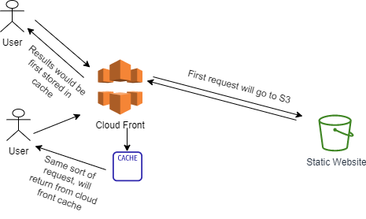
CloudFront
Cloud front is content distribution network (CDN)
This improves performance by caching the content at different edge locations
Users will get lower latency and improved performance
AWS keeps increasing edge locations (till this write there are 216 edge locations)
Cloud Front can work with
S3 - distributes files and cache at edge location and also uploading files to s3
Http Endpoints – ALB , EC2, Static S3 website

Slide 87
CloudFront – hands on
Create S3 bucket, upload index.html and an image, from code folder
The index.html can be accessed by Open button, but image won’t display as it is not public
The Object URL anyways won’t work
Create CloudFront distribution, chose origin domain as S3 bucket (choose the bucket which is created)
Origin access public cannot be selected, as bucket is not public. Also, Legacy access identities is old
Select ‘Origin access control settings (recommended)’ (will require a policy update on S3 , after CloudFront distribution is created). Then click on ‘Create control setting’ and Create with default settings.
Among all other settings, keep defaults and for WAF select ‘Do Not Enable Security Protection’ and for Default root object mention, index.html.
After creation, last modified will be deploying (wait for this to change). Also, there would be a message displayed to Copy Policy , paste that in S3. If not done at this moment, then you can follow below step.
On distribution -> Origins -> Edit -> Copy Policy and paste on S3. This policy will allow CloudFront to get objects from s3
Once deploying status is changed, copy distribution domain name and paste on browser
First time request will tale bit of time to display content but a refresh on browser latter will fetch content faster, as the content is cached
To Delete -> Disable distribution -> Wait for status to change from deploying and then delete distribution
On left menu -> Origin Access -> Delete
Delete S3 bucket

Slide 88
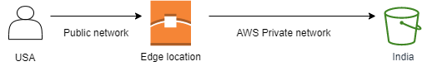
S3 transfer acceleration
S3, though global, but is location in a region
The user all around regions might want to upload content on S3
To speed up process, S3 transfer acceleration can help
User can upload file to nearest edge location, and file will be transferred to S3 via AWS private network
This will reduce latency for user
Scenario – if client wants to speed up the upload process to S3, then divide file in multipart and apply S3 transfer acceleration
To test if accelerator can help -
https://s3-accelerate-speedtest.s3-accelerate.amazonaws.com/en/accelerate-speed-comparsion.html

Slide 89
Communication

Slide 90
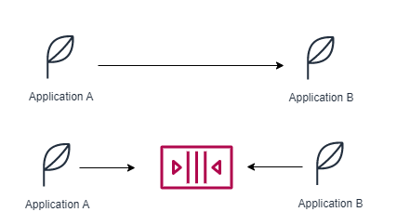
Application communication
Application can communication synchronously or asynchronously via some queue
With async way, the applications are decoupled and can process things as per their own capacity, can be scaled independently
AWS got SQS (Queue) , SNS (pub-sub) , Kinesis (near real time) services to process things in async manner
These services can also be scaled independently

Slide 91
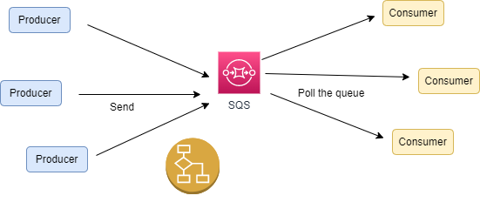
Simple queue service - sqs
Multiple producers can send messages
Multiple consumers can request messages form queue (polling)
Same message can’t be seen by 2 consumers
Once processed, message can be deleted from queue
Producers, Consumers are decoupled and along with SQS , can be scaled independently
Messages should be processed in max 14 days
No limits on volume of messages in queue

Slide 92
SQS – hands on
Create Queue -> Standard,
On Configuration section, click on info to read about details of each configuration setting
If consumer can’t process message in visibility time out, there is API , ChangeMessageVisibility, to get more time
See carefully details about Encryption and Access Policy
Click on Send and Receive Messages button (keep all other settings as default)
Write some hello message and click Send message. Send few more messages
Under Receive Message section, the Message available will be updated (might take time). The receive message section is like Queue and deletion simulates that message has been processed. If not deleted, the message should go back to queue in 30 seconds, which will be indicated by ‘Receive count’ column in Received message section.
Poll Messages will show the messages, Click on message to see body
Once seen delete the messages, to simulate deletion
Now send one more message and just click on Poll for Messages. Don’t delete and after 30 second click again poll for messages. The Receive count will increase. This is because the message is not process in visibility timeout settings (30 s) and it reappear.
Deleting message from queue, indicates SQS that message has been successfully processed
Back on Queue menu , there is Purge operations, which will delete all messages from queue
There are other tabs, like lambda triggers and monitoring and others
Don’t delete Queue , will be useful in SNS section
There will be SDK available, to send and poll messages from SQS

Slide 93
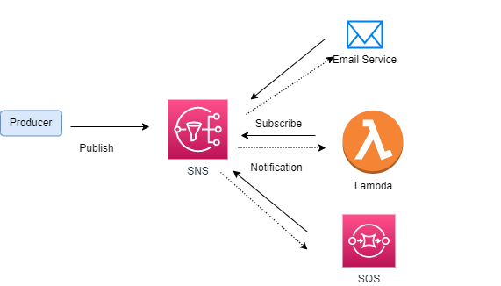
Simple notification service - SNS
What is a single message need to be delivered to multiple consumer at same time
Say you made purchase on ecom site and now this need to be notified to store owner, billing dept and courier service
There can be one service (topic) , to which consumers can be subscribed
Once message is published to that topic, all consumers will be notified with same message
SNS works in same fashion

Slide 94
SNS – Hands on
Create topic -> Standard , leave other fields default (but visit all tabs)
Now on AWS , after topic creation, Create Subscription , protocol as Email, Endpoint as <user>@email
For the email subscription, click that item (on left menu subscription) and request confirmation
A confirmation mail will be sent to your email account , click confirm subscription
Also create a subscription for the queue created earlier
Ensure on Queue, the SNS subscription is listed (sometime messages are not received, so copy arn of topic and recreate the subscription on Queue)
On Left Menu , select Topics, select topic created, Publish Message
Message will be available on inbox and also on SQS
Delete the SNS and SQS created

Slide 95

Kinesis overview
Makes easy to collect, process and analyze streaming data in real time, like logs, IoT data. Data should come fast.
4 flavors –
Kinesis Data Stream – capture, process and store data streams
Kinesis Data Firehose – load data streams to another AWS data stored (Redshift, S3, Opensearch, splunk, mongodb)
Kinesis Data Analytics – analyze data streams with SQL or Apache Flink
Kinesis Video Stream – capture process and store video streams

Slide 96
Other services

Slide 97
CloudWatch
CloudWatch provides metrics for lot of services
Like for EC2 , it will provide CPUUtilization, network metrics etc.
For Disks, it will provide disk read/writes etc.
For S3, no of objects , requests etc.,
Based on metrics Alarms can also be created to trigger some actions
Like say when a CPUUtilization is exceeding 80%, do trigger a mail
Billing metrics is only available in us-east-1 region
CloudWatch logs are also available for almost all services

Slide 98
CloudWatch – Hands on
Create a EC2 instance (for its metrics to appear)
Meanwhile CloudWatch – Metrics – All Metrics will show metrics available for all AWS Services
Can see all EC2 metrics available
Left Menu -> Create Alarm -> Select Metrics -> EC2 -> Per Instance Metrics -> Search with instanceId -> CPUUtilization > (Average for 5 min ) 80%
In Additional configuration, put 3 as datapoints (each data point is at 5 min, so when CPU is 80% for 15 min , this alarm will trigger)
On next button click , select EC2 action and with In alarm, select Terminate the instance (The Notification details are filled by default and need to be removed). Create Alarm
The alarm will be in state Insufficient data or Ok. We need to do something on EC2 to put CPU utilization above 80% or simulate the scenario to trigger alarm to set alarm state. Let’s simulate
Google for - aws cloudwatch set alarm state and open cloud shell , refer doc to run command as –
aws cloudwatch set-alarm-state --alarm-name <alarm_name> --state-value ALARM --state-reason “Simulating alarm”
Now the alarm will be in ‘In alarm’ state which will terminate your EC2 instance
Delete the alarm

Slide 99
Amazon Eventbridge
Either scheduling something to happen or taking some action on something (on some event)
Can schedule cronjob like every day, to trigger a Lambda function which backups database, so it will generate event every day to execute lambda function
Event Pattern – React to service events, like EC2 instance stopping, starting or root user signings or object uploaded to S3
Can notify other AWS services targets like SNS , SQS, can launch lambda, can start ECS task, can stream to Kinesis data stream and lot others
Search for EventBridge on AWS console (will target only Rule creation and associated pieces)
Create Rule -> Default Event bus -> Rule type -> Schedule -> Continue to create rule -> Schedule pattern gives option for either cron job or regular rate -> On next Page you can select AWS service such as lambda.
Once rule is setup , the target AWS service will be invoked accordingly
Create Rule -> Default Event bus -> Rule type -> Schedule -> Continue in Event Bridge Scehduler
On schedule pattern you have choices for one time or recurring schedule. On recurring you have same cron job and regular rate scheduling options . On next page you can select the target service but on next page you have more options that earlier one to like action after scheduling, retry policy in case say AWS target lambda fails and others
Create Rule-> Rule with an event pattern as Rule type . Here Eventbridge rule can be triggered on patterns like shutting down on EC2 instance shutting down or starting or EC2 autoscaling or Cloud watch alarm change and 100 others

Slide 100
Amazon Eventbridge- hands on
There will be a rule triggered when EC2 instance is stopped and SQS queue will be notified
Create a EC2 instance and a SQS Queue
Create rule-> Select Rule with an event pattern as rule type-> Keep default settings and in Sample Events with event type as AWS events , select Sample Event as ‘EC2 Instance State-change Notification’ and Sample event 4 (This piece is optional but after this step , when we select actual event pattern , that pattern will emit events and can compared to this, to match. If matched, then rule will trigger event.)
Now in Creation Method and in Event Pattern select AWS Service as EC2 and event type as ‘EC2 Instance State-change Notification’ and then in specific event select stopped and terminated -> and in Event type Specification 2 , keep Any Instance. Now click on Test Pattern and message will indicate if Event Pattern matching to Sample Event.
In Event type Specification 2, select Specific Instance Id and paste the EC2 instanceId, we created earlier
On Next screen set target as SQS queue and select the SQS we created earlier. Create the rule.
Stop the EC2 instance and observe the queue, A message will be available, poll the message to see the details
Another example (Hands on)
Create a lambda and -> Configuration tab -> Add trigger -> Select Trigger Configuration as EventBridge -> Create new Rule -> select Scheduled expression as Rule type -> Input rate(1 day) and then Add. This will invoke lambda once in a day
Delete EC2, SQS, Lambda and Event bridge rules

Slide 101
AWS Security- Attacks
AWS Web Application Firewall (WAF) filters request based on IP Address, Http Header , Http Body etc., Can protect against SQL and CSS attack
DDoS – Distributed Denial-of-Service attach
Attacker may hit lots of requests to your application via automated bots and application freezes at some point of time and become nonresponsive
AWS Shiels Standard protects applications from such attacks and is free
CloudFront and Route53 coupled with AWS Shield can protect at edge itself
AWS Advance Shield comes with loads of other features to give premium protection 24/7 and is not free
AWS Firewall Manager is a security management service that allows you to centrally configure and manage firewall rules across your accounts and applications in AWS Organizations.

Slide 102
AWS Security- Encryption
When data is stored in S3 or RDS, that data is sitting on disk/database and Is called as data at rest
When data is being passed from say browser to application, is called data in transit
To project data, that need encryption by some keys
Data at rest can be protected by AWS Key management service, which got keys to encrypt data (Search for KMS on AWS Console)
The keys are managed by AWS or even can be managed by customers
AWS certificate manager manage SSL/TLS certificates to make site accessible over https (Search for certificate Manager on AWS console)
https ensure data is encrypted in-flight
AWS secret manager holds sensitive data like password and can be integrated with RDS (MYSQL, Postgres, Aurora), to generate secrets (Search for Secret Manager on AWS Console)
Secrets can be rotated after X days
Applications can use SDK to retrieve secrets

Slide 103
API Gateway - Serverless
Offering to create REST APIs for client, those are public and accessible to clients
Expose any AWS to outside world
Say there are few Http APIs expose by Lambda , API gateway can then proxy client request to Lambda functions Http APIs
API gateway can manage authentication and authorization
Can handle request throttling , rate limiting
OpenAPI/Swagger can be used to import APIs
Transform and validate request/response at API gateway level
Cache API responses
Can be integrated with Lambda, any Http API on on-prem and AWS Services (SQS, Step Workflows , Kinesis, etc.,)
Custom domain name can be integrated over https, using AWS Certificate manager

Slide 104
API Gateway - Endpoints
Edge Optimized - For global clients
Can be accessible from anywhere in the world from edge locations
Request routing thru cloudfront edge location to improve latency
But gateway itself will reside in region
Regional – For Client within same region
Private – Can only be access from VPC

Slide 105
API Gateway – hands on
Create 2 Lambdas – say with nodejs – and change messages like to ‘hello from API-1’ and ‘hello from API-2’
Search API Gateway in AWS Console -> Create -> Chose REST API -> Build. Api Endpoint -> Regional
After creation -> Create method -> GET -> Chose Lambda Integration and the 1st Lambda we created . Also enable proxy integration (Go to Lambda page on AWS console and now you can see on pic, that API gateway can invoke that Lambda function) (Also a policy is added to Lambda , to be invoked from API gateway)
Back on API gateway page, the dia. Indicates request flow and response. There is Test tab. Click Test to test the API and see response
Create Resource and give Resource name as ‘second-api’. Repeat same process to Create method, to integrate with 2nd Lambda function. Test it out to see response
To access APIs from web browser, these need to be Deployed. Click on Deploy to a stage ‘Dev’
Left Menu -> Stages -> Involve URL will be displayed which can be pasted on browser to get response for REST APIs. Also <invoke_url>/second-api to see response for 2nd API
Conti….. On next page
Notes:
Hands on from Sol Architect + https://www.youtube.com/watch?v=fN9rL3vBgyU

Slide 106
API Gateway integration Certificate manager– hands on
Ensure Route53 entries in hosted zone and NS populated in Domain provider
Back on API Gateway , Custom domain names -> Create -> chandra-learnings.co.in -> TLS 1.2 -> Regional -> Create Certificate
On AWS Certificate Manager -> Request Certificate -> fully qualified domain name -> chandra-learnings.co.in . Go on Request and Click on Create records in Route 53. In couple of min, Certificate will have state as Issued (Assumption is Hosted zone is created in Route-53)
Back in API Gateway -> Select the certificate -> Create domain name
Create on tab API Mappings -> Configure API mapping -> Add new mapping -> Select the API gateway and Stage and Save (If Stage is not appearing , go back to API Gateway page and come again)
On configuration tab -> note domain name (will be needed on Route 53)
Go to Route53 -> Create record inside hosted Zone -> keep Record name as blank -> Record type as A -> Enable Alias and select your API gateway -> Create record
On next page , there will be View Status button. Wait till Status is INSYNC
Now hit on browser say https://chandra-learnings.co.in/ and https://chandra-learnings.co.in/second-api
Plain Http won’t render anything
Delete custom domain, api, CNAME and A record from Route-53, Certificate, Lambdas (Certification deletion might complain but try after an hour or so)
Notes:
Hands on from Sol Architect + https://www.youtube.com/watch?v=fN9rL3vBgyU

Slide 107
Machine learning services
Amazon Rekognition – Analyze text, faces, objects within images/videos
Can be used in face detection softwares like to determine gender, age or to label images
Amazon Transcribe – Converts Speech to Text
Removed Personally Identifiable Information (PII) like age, phone number using Redaction
Helpful in customer service calls (Can show on AWS Console)
Amazon Polly – Converts Text to Speech, useful in examination for our visually impaired brothers (Can show on AWS Console)
Amazon translate – Localize content of website or application for international users (Can show on AWS Console)

Slide 108
AWS Command line interface (aws-cli)
AWS CLI is tool to manage aws services from command line
Installation –
https://docs.aws.amazon.com/cli/latest/userguide/getting-started-install.html
Once installed, run
aws configure
And fill in values for access_key, secret_key, region
S3 command
aws s3 mb s3://bucket-stroing-tfstate
aws s3 ls
aws s3 rb s3://bucket-stroing-tfstate --force
Notes:
while using cli you might get An error occurred (AuthFailure) when calling the RunInstances operation: AWS was not able to validate the provided access credentials
this is time clock issue
run following command
sudo hwclock -s

Slide 109
AWS Command line interface (aws-cli)
EC2 command
aws ec2 create-key-pair --key-name tf-key-pair --key-type rsa --key-format pem --query "KeyMaterial" --output text > tf-key-pair.pem
(--query "KeyMaterial" prints the private key material to the output.)
aws s3 ls
aws ec2 describe-key-pairs --key-name tf-key-pair
aws ec2 describe-subnets (get vpc id and subnet id)
aws ec2 create-security-group --group-name cli-sg --description "CLI security group" --vpc-id <vpc_id>
aws ec2 authorize-security-group-ingress --group-id <sg_id> --protocol tcp --port 22 --cidr 0.0.0.0/0
aws ec2 describe-security-groups --group-ids <sg_id>
aws ec2 run-instances --image-id ami-049a62eb90480f276 --count 1 --instance-type t2.micro --key-name tf-key-pair --subnet-id <subnet_id> --security-group-ids <sg_id> --tag-specifications 'ResourceType=instance,Tags=[{Key=Name,Value=ec2-by-cli}]' --region ap-south-1
aws ec2 describe-instances --filters 'Name=tag:Name,Values=ec2-by-cli' | grep InstanceId
aws ec2 terminate-instances --instance-ids <instance_id>
aws ec2 delete-security-group --group-id <sg_id>
Notes:
while using cli you might get An error occurred (AuthFailure) when calling the RunInstances operation: AWS was not able to validate the provided access credentials
this is time clock issue
run following command
sudo hwclock -s

Slide 110
Further learning
Filtering – how to filter data when say price is greater than or less than
Atlas mongo features
Views with java script
Tool for mongo db, like Mongo Compass

Slide 111
SUMMARY
We learnt few features of node js, which enables us to design a MVC application where middleware interacts with backend.
We user atlas mongo db as our database, which is primarily used for node js
Always prefer node js for faster applications and not for CPU intensive applications

